Slide 1
COMP 2230
Week 13 - Friday

Slide 2
Last time
Finite-state automata

Slide 3
Questions?

Slide 4
Assignment 6

Slide 5


Logical warmup
What's the length of the rectangle's diagonal, running from A to B?
A
$$6$$
B
$$4$$

Slide 6
Back to Finite-State Automata

Slide 7
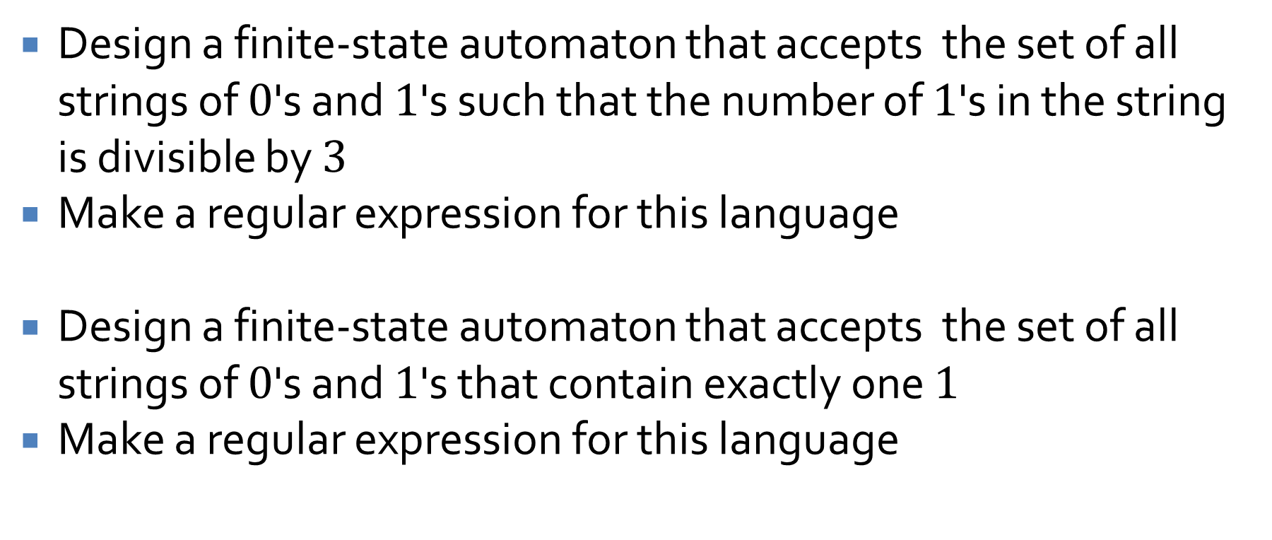
Designing automata
Design a finite-state automaton that accepts the set of all strings of $0$'s and $1$'s such that the number of $1$'s in the string is divisible by $3$
Make a regular expression for this language
Design a finite-state automaton that accepts the set of all strings of $0$'s and $1$'s that contain exactly one $1$
Make a regular expression for this language

Slide 8
FSA = regular expressions
Kleene's Theorem shows that finite-state automata are equivalent to regular expressions
That is, for every finite-state automaton there is some equivalent regular expression, and vice versa
We won't prove it, but it should be intuitively clear because there are algorithms for building FSA's from regular expressions and vice versa

Slide 9
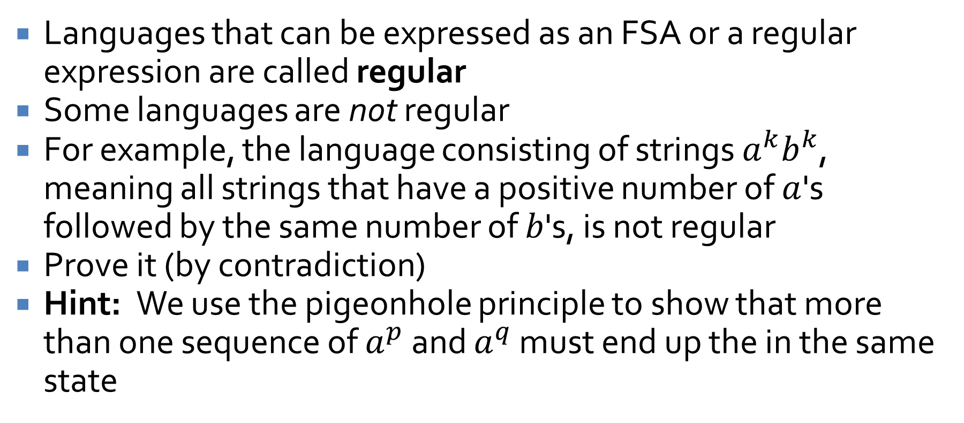
Irregular
Languages that can be expressed as an FSA or a regular expression are called regular
Some languages are not regular
For example, the language consisting of strings $a^{k}b^{k}$, meaning all strings that have a positive number of $a$'s followed by the same number of $b$'s, is not regular
Prove it (by contradiction)
Hint: We use the pigeonhole principle to show that more than one sequence of $a^{p}$ and $a^{q}$ must end up the in the same state

Slide 10
Simplifying FSAs
Three-Sentence Summary

Slide 11
Simplifying FSAs

Slide 12




















Comparison
List strings accepted by the FSA $A$
List strings accepted by the FSA $B$
$$A$$
$$B$$
$$0$$
$$0$$
$$s_{0}$$
$$1$$
$$s_{1}$$
$$0$$
$$0$$
$$1$$
$$1$$
$$1$$
$$s_{0}$$
$$s_{1}$$
$$1$$
$$s_{3}$$
$$s_{2}$$
$$1$$
$$0$$
$$0$$

Slide 13
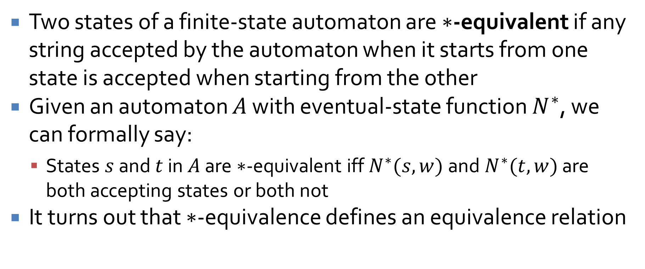
*-equivalence
Two states of a finite-state automaton are $∗$-equivalent if any string accepted by the automaton when it starts from one state is accepted when starting from the other
Given an automaton $A$ with eventual-state function $N^{∗}$, we can formally say:
States $s$ and $t$ in $A$ are $∗$-equivalent iff $N^{∗}(s,w)$ and $N^{∗}(t,w)$ are both accepting states or both not
It turns out that $∗$-equivalence defines an equivalence relation

Slide 14
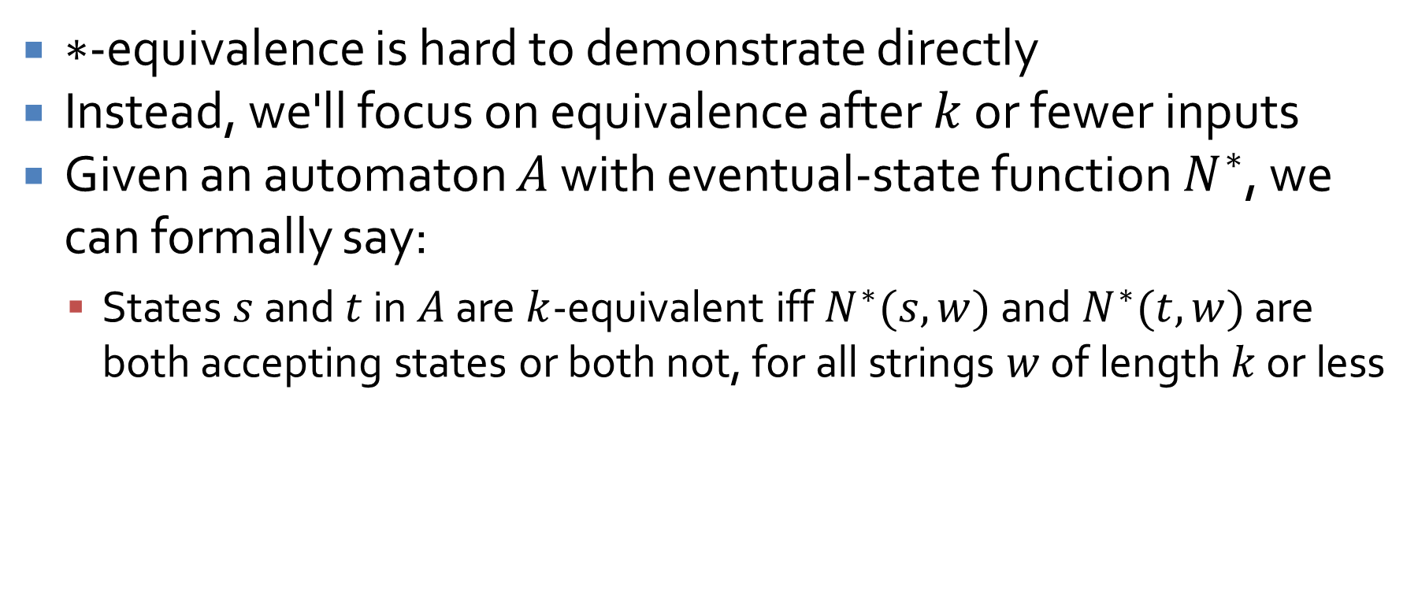
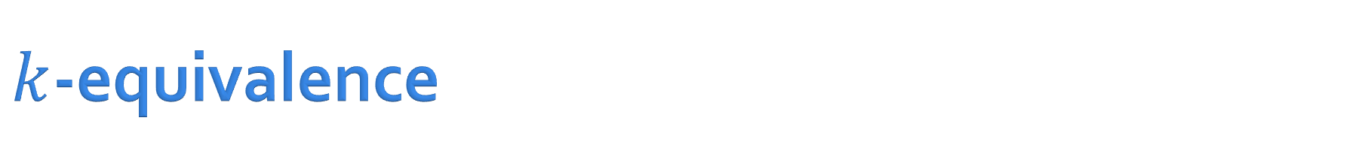
$k$-equivalence
$∗$-equivalence is hard to demonstrate directly
Instead, we'll focus on equivalence after $k$ or fewer inputs
Given an automaton $A$ with eventual-state function $N^{∗}$, we can formally say:
States $s$ and $t$ in $A$ are $k$-equivalent iff $N^{∗}(s,w)$ and $N^{∗}(t,w)$ are both accepting states or both not, for all strings $w$ of length $k$ or less

Slide 15
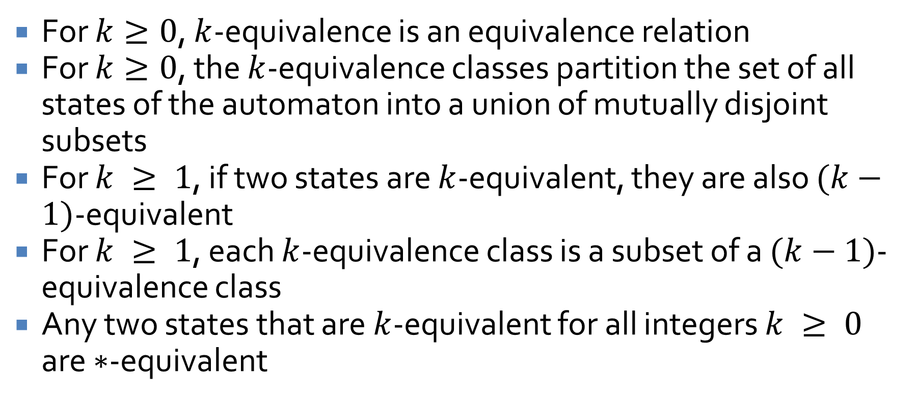
Facts about k-equivalence
For $k≥0$, $k$-equivalence is an equivalence relation
For $k≥0$, the $k$-equivalence classes partition the set of all states of the automaton into a union of mutually disjoint subsets
For $k ≥ 1$, if two states are $k$-equivalent, they are also $(k−1)$-equivalent
For $k ≥ 1$, each $k$-equivalence class is a subset of a $(k−1)$-equivalence class
Any two states that are $k$-equivalent for all integers $k ≥ 0$ are $∗$-equivalent

Slide 16
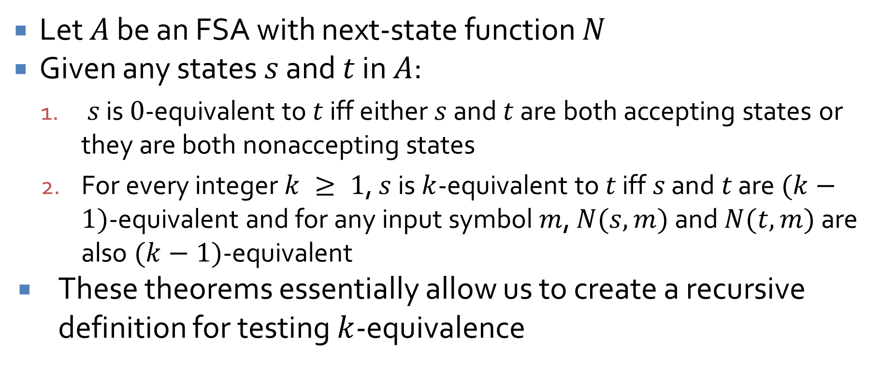
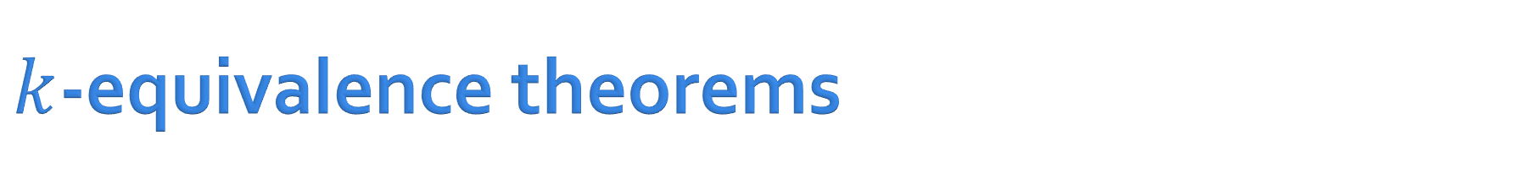
$k$-equivalence theorems
Let $A$ be an FSA with next-state function $N$
Given any states $s$ and $t$ in $A$:
$s$ is $0$-equivalent to $t$ iff either $s$ and $t$ are both accepting states or they are both nonaccepting states
For every integer $k ≥ 1$, $s$ is $k$-equivalent to $t$ iff $s$ and $t$ are $(k−1)$-equivalent and for any input symbol $m$, $N(s,m)$ and $N(t,m)$ are also $(k−1)$-equivalent
These theorems essentially allow us to create a recursive definition for testing $k$-equivalence

Slide 17



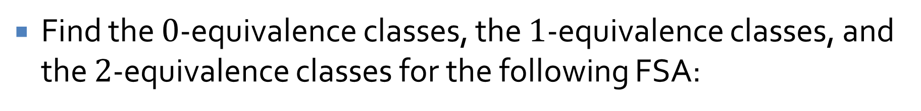



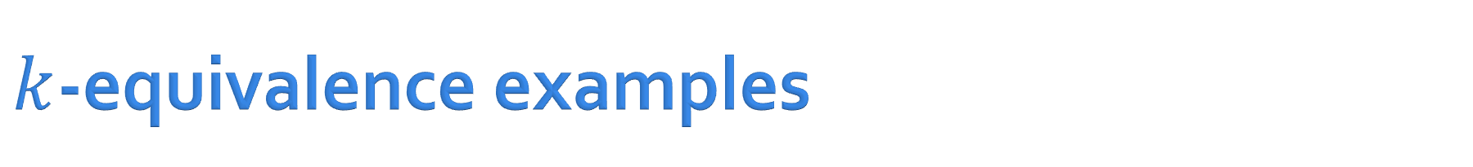









$k$-equivalence examples
Find the $0$-equivalence classes, the $1$-equivalence classes, and the $2$-equivalence classes for the following FSA:
$$1$$
$$s_{0}$$
$$1$$
$$s_{1}$$
$$0$$
$$s_{2}$$
$$0$$
$$1$$
$$1$$
$$1$$
$$0$$
$$0$$
$$s_{4}$$
$$s_{3}$$
$$0$$

Slide 18
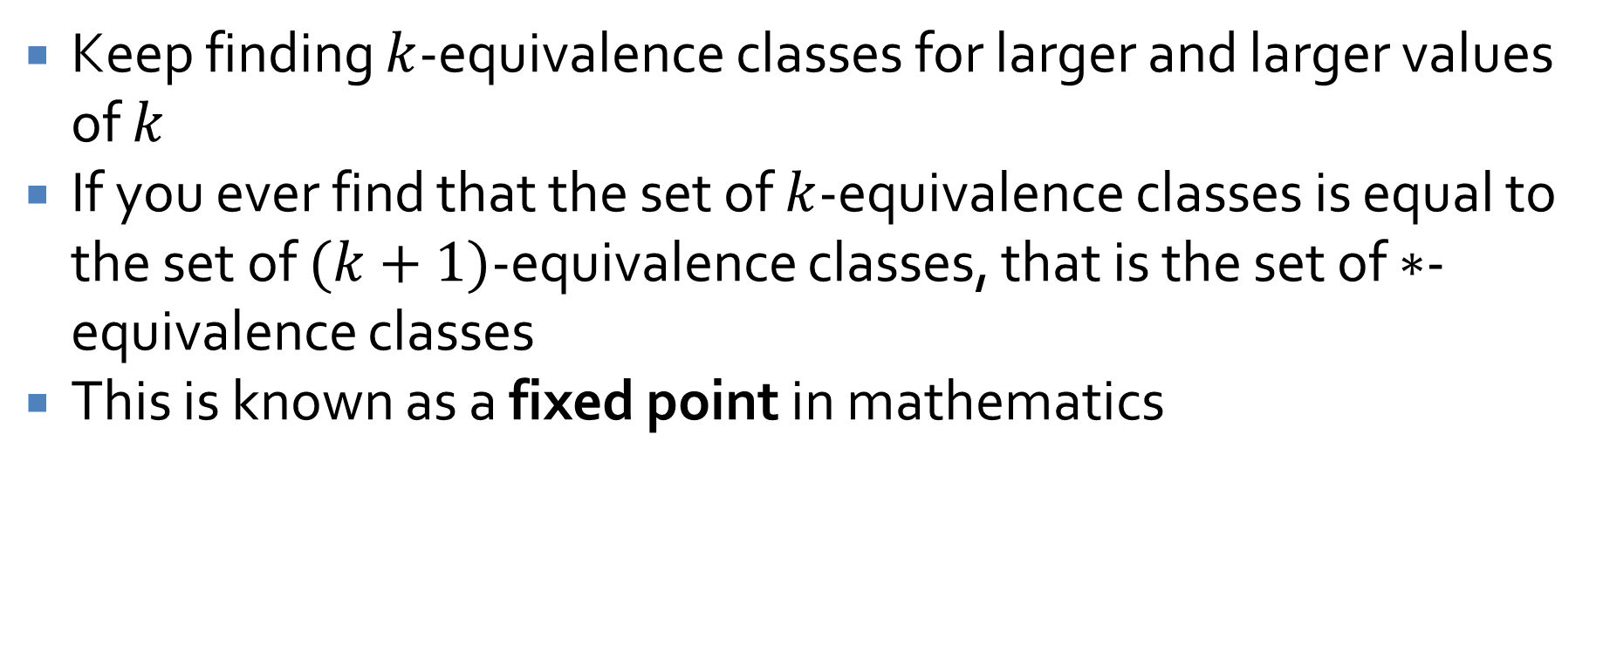

Finding the $∗$-equivalence classes
Keep finding $k$-equivalence classes for larger and larger values of $k$
If you ever find that the set of $k$-equivalence classes is equal to the set of $(k+1)$-equivalence classes, that is the set of $∗$-equivalence classes
This is known as a fixed point in mathematics

Slide 19
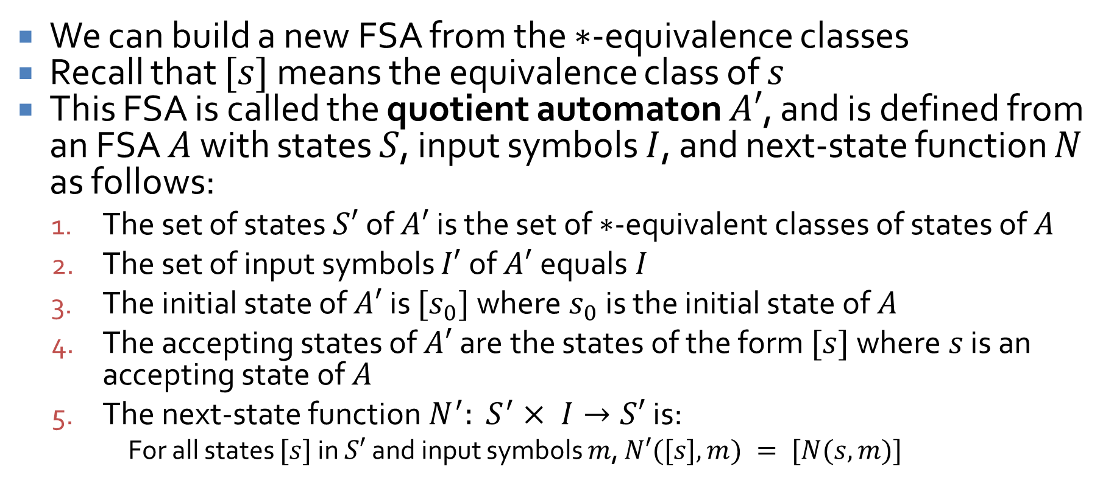
The quotient automaton
We can build a new FSA from the $∗$-equivalence classes
Recall that $[s]$ means the equivalence class of $s$
This FSA is called the quotient automaton $A′$, and is defined from an FSA $A$ with states $S$, input symbols $I$, and next-state function $N$ as follows:
The set of states $S′$ of $A′$ is the set of $∗$-equivalent classes of states of $A$
The set of input symbols $I′$ of $A′$equals $I$
The initial state of $A′$ is $[s_{0}]$ where $s_{0}$ is the initial state of $A$
The accepting states of $A′$ are the states of the form $[s]$ where $s$ is an accepting state of $A$
The next-state function $N^{′}: S^{′}× I→S′$ is:
For all states $[s]$ in $S′$ and input symbols $m$, $N′([s], m) = [N(s,m)]$

Slide 20
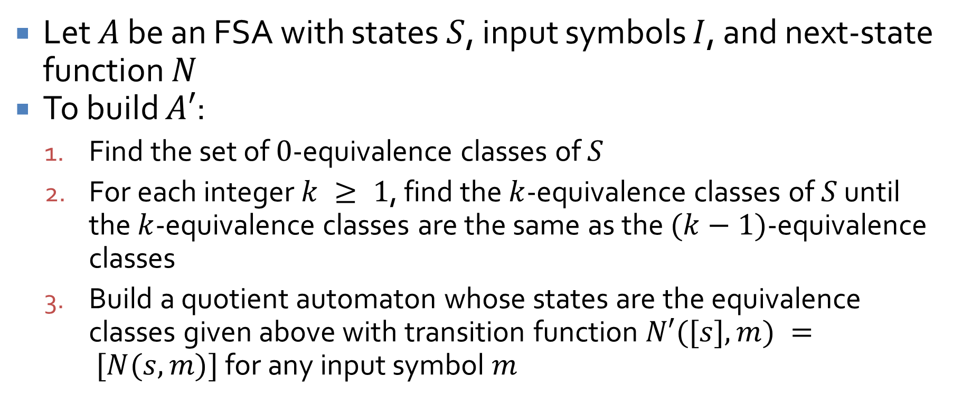
Constructing a quotient automaton
Let $A$ be an FSA with states $S$, input symbols $I$, and next-state function $N$
To build $A′$:
Find the set of $0$-equivalence classes of $S$
For each integer $k ≥ 1$, find the $k$-equivalence classes of $S$ until the $k$-equivalence classes are the same as the $(k−1)$-equivalence classes
Build a quotient automaton whose states are the equivalence classes given above with transition function $N′([s],m) = [N(s,m)]$for any input symbol $m$

Slide 21
Quotient automaton example
Find the quotient automaton for the following FSA
$$1$$
$$s_{0}$$
$$1$$
$$s_{1}$$
$$0$$
$$s_{2}$$
$$0$$
$$1$$
$$1$$
$$1$$
$$0$$
$$0$$
$$s_{4}$$
$$s_{3}$$
$$0$$

Slide 22
Ticket Out the Door

Slide 23
Upcoming

Slide 24
Next time…
Finishing simplifying FSAs
Context-free grammars and pushdown automata

Slide 25
Reminders
Keep working on Assignment 6

